Slide 1
Todo App
Using a local file db
Group Members:
Ahmar Khan
Daniyal Ahmed
M. Faheem
Hassan Imran
Om Lohano

Slide 2
Folder Structure
Project
api
client
db
Node files
React / redux files

Slide 3
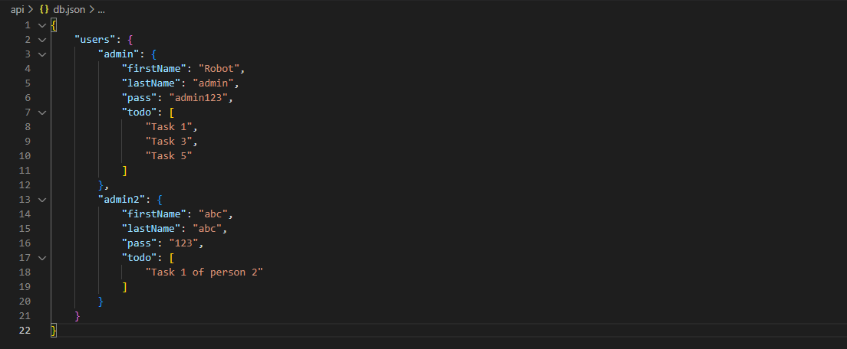
Database Structure
Key-value pair design to make data access fast and remove any redundant action of traversal

Slide 4
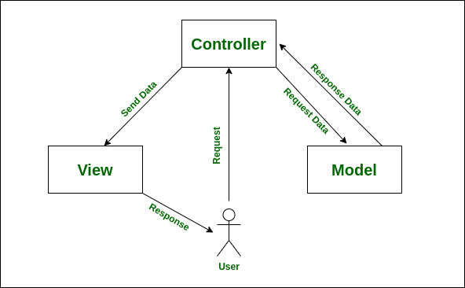
Understanding MVC architecture for MERN

